Slide 1

Time Series Analysis and Forecasting in R
Abhishek Singh
Department of Mathematics
National Institute of Technology Hamirpur
Himachal Pradesh
Email: abhishek@nith.ac.in

Slide 2
Outline
Basics – Time Series Modeling
Exploration of Data in R
Introduction to ARMA Modeling
Framework of ARIMA Modeling
Practice with an example

Slide 3
Introduction
Time Series, which deals with time based data and it involves working on time such as years, days, hours, minutes etc., to derive hidden insights to make informed decision making.
Time series models are very useful models when we serially correlated data. Most of business houses work on time series data to analyze sales number for the next year, website traffic, competition position and much more.

Slide 4
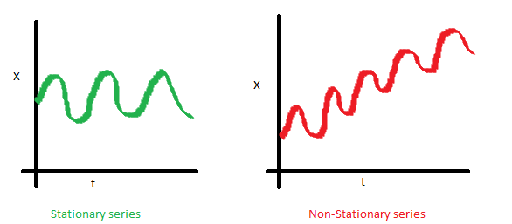
Basics: Time Series Modeling
Stationary Series
The mean of the series should not be a function of time rather should be a constant. The image below has the left hand graph satisfying the condition whereas the graph in red has a time dependent mean.

Slide 5
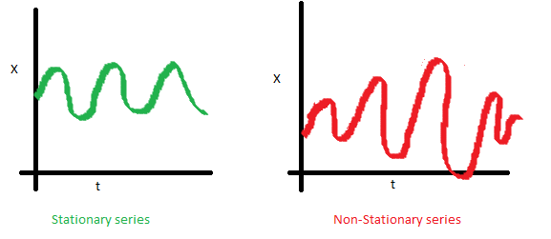
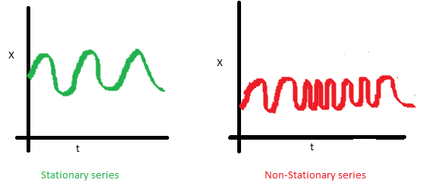
The variance of the series should not a be a function of time. This property is known as homoscedasticity.
The covariance of the i^{th} term and the (i + k)^{th} term should not be a function of time. In the following graphs, we can notice the spread becomes closer as the time increases. Hence, the covariance is not constant with time.

Slide 6
Why should we care about ‘stationarity’ of a time series?
If the data is non-stationary, we cannot build a time series model.
In cases where the stationary criterion are violated, the first requisite becomes to Stationarize the time series and then try stochastic models to predict this time series. There are multiple ways of bringing this stationarity. Some of them are De-trending, Differencing etc.

Slide 7
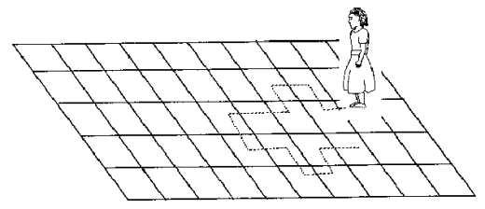
Random Walk
Imagine a girl moving randomly on a giant chess board. In this case, next position of the girl is only dependent on the last position.
Now imagine, we were sitting in another room and are not able to see the girl. We want to predict the position of the girl with time. How accurate will it be?

Slide 8
At t=0 we exactly know where the girl is. Next time, she can only move to 8 squares and hence our probability dips to 1/8 instead of 1 and it keeps on going down. Now let’s try to formulate this series :
X(t) = X(t-1) + Er(t)
where Er(t) is the error at time point t. This is the randomness the girl brings at every point in time.
Now, if we recursively fit in all the X’s, we will finally end up to the following equation :
X(t) = X(0) + Sum(Er(1),Er(2),Er(3).....Er(t))

Slide 9
Validating our assumptions of stationary series on this random walk formulation
Is the Mean constant ?
E[X(t)] = E[X(0)] + Sum(E[Er(1)],E[Er(2)],E[Er(3)].....E[Er(t)])
We know that Expectation of any Error will be zero as it is random. Hence we get E[X(t)] = E[X(0)] = Constant.
Is the Variance constant?
Var[X(t)] = Var[X(0)] + Sum(Var[Er(1)],Var[Er(2)],Var[Er(3)].....Var[Er(t)])
Var[X(t)] = t * Var(Error) = Time dependent.
Hence, we infer that the random walk is not a stationary process as it has a time variant variance. Also, if we check the covariance, we see that too is dependent on time.

Slide 10
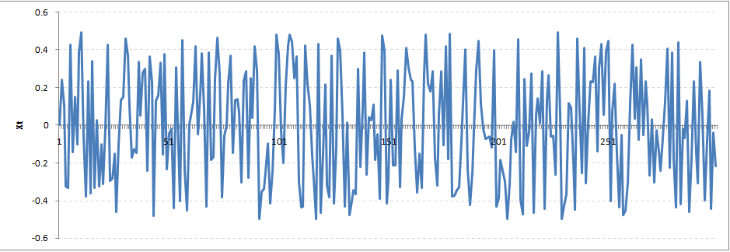
Introduce the coefficient : Rho
X(t) = Rho * X(t-1) + Er(t)
Now, we will vary the value of Rho to see if we can make the series stationary. Here we will interpret the scatter visually and not do any test to check stationarity.
Let’s start with a perfectly stationary series with Rho = 0. Here is the plot for the time series :

Slide 11
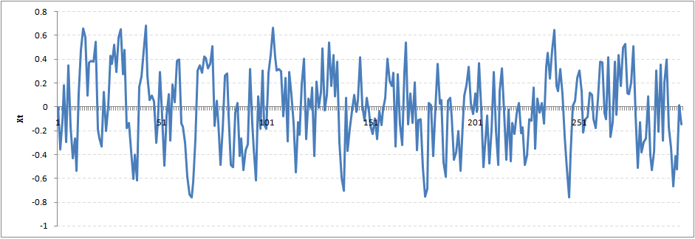
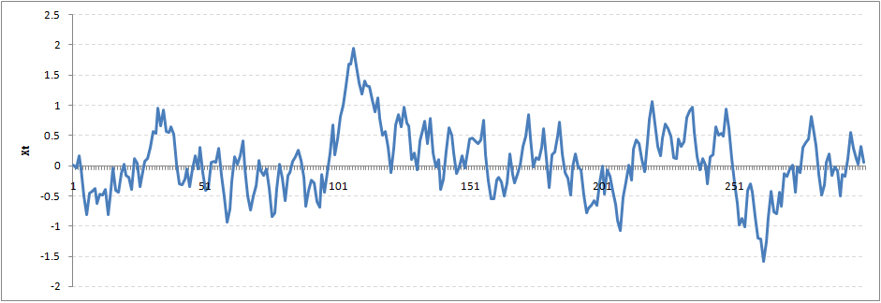
Increase the value of Rho to 0.5 gives us following graph :
We can notice that our cycles have become broader but essentially there does not seem to be a serious violation of stationary assumptions. Let’s now take a more extreme case of Rho = 0.9

Slide 12
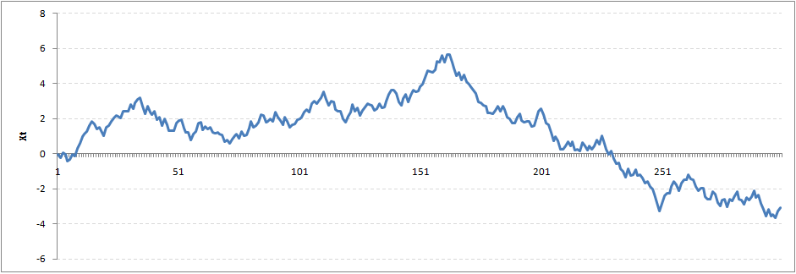
We still see that the X returns back from extreme values to zero after some intervals. This series also is not violating non-stationarity significantly. Now, let’s take a look at the random walk with rho = 1.

Slide 13
Dickey Fuller Test of Stationarity
Here is a small tweak which is made for our equation to convert it to a Dickey Fuller test:
X(t) = Rho * X(t-1) + Er(t)
=> X(t) - X(t-1) = (Rho - 1) X(t - 1) + Er(t)
We have to test if Rho – 1 is significantly different than zero or not. If the null hypothesis gets rejected, we’ll get a stationary time series.
Stationary testing and converting a series into a stationary series are the most critical processes in a time series modeling.

Slide 14
Introduction to ARMA Time Series Modeling
In ARMA model, AR stands for auto-regression and MA stands for moving average.
AR or MA are not applicable on non-stationary series.
In case you get a non stationary series, you first need to stationarize the series (by taking difference / transformation) and then choose from the available time series models.
We will discuss each of these two models (AR & MA) individually. Next, will look at the characteristics of these models.

Slide 15
Auto-Regressive (AR) Model
The current GDP of a country say x(t) is dependent on the last year’s GDP i.e. x(t – 1). The hypothesis being that the total cost of production of products & services in a country in a fiscal year (known as GDP) is dependent on the set up of manufacturing plants / services in the previous year and the newly set up industries / plants / services in the current year.
Hence, we can formally write the equation of GDP as:
x(t) = alpha * x(t – 1) + error (t)
This equation is known as AR(1) formulation. The numeral one (1) denotes that the next instance is solely dependent on the previous instance. The alpha is a coefficient which we seek so as to minimize the error function. Notice that x(t- 1) is indeed linked to x(t-2) in the same fashion. Hence, any shock to x(t) will gradually fade off in future.

Slide 16
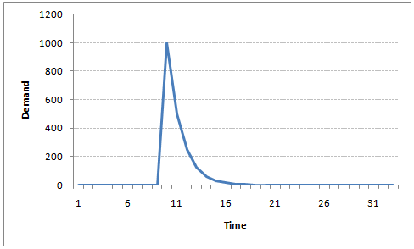
For instance, let’s say x(t) is the number of juice bottles sold in a city on a particular day. During winters, very few vendors purchased juice bottles. Suddenly, on a particular day, the temperature rose and the demand of juice bottles soared to 1000. However, after a few days, the climate became cold again. But, knowing that the people got used to drinking juice during the hot days, there were 50% of the people still drinking juice during the cold days. In following days, the proportion went down to 25% (50% of 50%) and then gradually to a small number after significant number of days.
The following graph explains the inertia property of AR series:

Slide 17
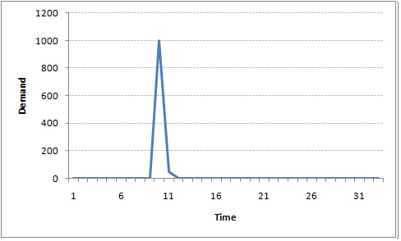
Moving Average (MR) Model
A manufacturer produces a certain type of bag, which was readily available in the market. Being a competitive market, the sale of the bag stood at zero for many days. So, one day he did some experiment with the design and produced a different type of bag. This type of bag was not available anywhere in the market. Thus, he was able to sell the entire stock of 1000 bags (lets call this as x(t)). The demand got so high that the bag ran out of stock. As a result, some 100 odd customers couldn’t purchase this bag. Lets call this gap as the error at that time point. With time, the bag had lost its woo factor. But still few customers were left who went empty handed the previous day. Following is a simple formulation to depict the scenario :
x(t) = beta * error(t-1) + error (t)

Slide 18
Difference between AR and MA models
The primary difference between an AR and MA model is based on the correlation between time series objects at different time points.
The correlation between x(t) and x(t-n) for n > order of MA is always zero. This directly flows from the fact that covariance between x(t) and x(t-n) is zero for MA models (something which we refer from the example taken in the previous section).
However, the correlation of x(t) and x(t-n) gradually declines with n becoming larger in the AR model. This difference gets exploited irrespective of having the AR model or MA model.
The correlation plot can give us the order of MA model.

Slide 19
Exploiting ACF and PACF plots
Is it an AR or MA process?
What order of AR or MA process do we need to use?
The first question can be answered using Total Correlation Chart (also known as Auto – correlation Function / ACF). ACF is a plot of total correlation between different lag functions. For instance, in GDP problem, the GDP at time point t is x(t). We are interested in the correlation of x(t) with x(t-1) , x(t-2) and so on.
In a moving average series of lag n, we will not get any correlation between x(t) and x(t – n -1) . Hence, the total correlation chart cuts off at n^{th} lag. So it becomes simple to find the lag for a MA series. For an AR series this correlation will gradually go down without any cut off value.
Here is the second trick. If we find out the partial correlation of each lag, it will cut off after the degree of AR series. For instance, if we have a AR(1) series, if we exclude the effect of 1st lag (x (t-1) ), our 2nd lag (x (t-2)) is independent of x(t). Hence, the partial correlation function (PACF) will drop sharply after the 1st lag.

Slide 20
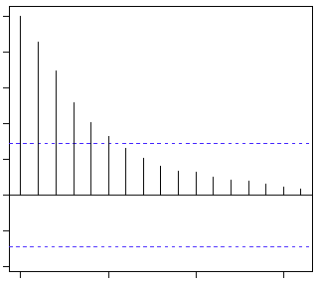
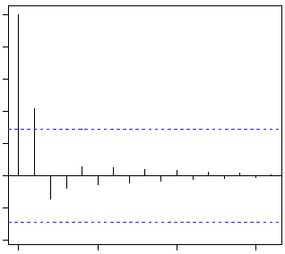
Following are the examples of ACF and PACF :
ACF PACF
The blue line above shows significantly different values than zero. Clearly, the graph above has a cut off on PACF curve after 2nd lag which means this is mostly an AR(2) process.

Slide 21
Clearly, the graph above has a cut off on ACF curve after 2nd lag which means this is mostly a MA(2) process.

Slide 22
ARIMA Model
Visualize the time series
Stationarize the series
Plot ACF/PACF charts and find optimal parameters
Build the ARIMA model
Make Predictions

Slide 23
Step 1: Visualize the Time Series
It is essential to analyze the trends prior to building any kind of time series model. The details we are interested in pertains to any kind of trend, seasonality or random behavior in the series. We have covered this part in the second part of this series.
Step 2: Stationarize the Series
Once we know the patterns, trends, cycles and seasonality , we can check if the series is stationary or not. Dickey – Fuller is one of the popular test to check the same.

Slide 24
1. De-trending : Here, we simply remove the trend component from the time series. For instance, the equation of my time series is:
x(t) = (mean + trend * t) + error
We’ll simply remove the part in the parentheses and build model for the rest.
2. Differencing : This is the commonly used technique to remove non-stationarity. Here we try to model the differences of the terms and not the actual term. For instance,
x(t) – x(t-1) = ARMA (p , q)
This differencing is called as the Integration part in AR(I)MA. Now, we have three parameters
p : AR (Auto Regressive)
d : I (Integrated)
q : MA (Moving Averages)
3. Seasonality : Seasonality can easily be incorporated in the ARIMA model directly. More on this has been discussed in the applications part below.

Slide 25
Step 3: Find Optimal Parameters
The parameters p,d,q can be found using ACF and PACF plots. An addition to this approach is can be, if both ACF and PACF decreases gradually, it indicates that we need to make the time series stationary and introduce a value to “d”.
Step 4: Build ARIMA Model
With the parameters in hand, we can now try to build ARIMA model. The value found in the previous section might be an approximate estimate and we need to explore more (p,d,q) combinations. The one with the lowest BIC and AIC should be our choice. We can also try some models with a seasonal component. Just in case, we notice any seasonality in ACF/PACF plots.
Step 5: Make Predictions
Once we have the final ARIMA model, we are now ready to make predictions on the future time points. We can also visualize the trends to cross validate if the model works fine.

Slide 26
ARIMA (p, d, q) (P, D, Q)_{m}
ARIMA (p, d, q) (P, D, Q)_{m}: the first parenthesis represents the non-seasonal part of the model and second represents the seasonal part of the model, where m= number of periods per season. We use uppercase notation for the seasonal parts of the model, and lowercase notation for the non-seasonal parts of the model. The additional seasonal terms are simply multiplied with the non-seasonal terms.
The seasonal part of an AR or MA model will be seen in the seasonal lags of the PACF and ACF. For example, an ARIMA(0,0,0)(0,0,1)₁₂ model will show: a spike at lag 12 in the ACF but no other significant spikes. The PACF will show exponential decay in the seasonal lags; that is, at lags 12, 24, 36,….etc. Similarly, an ARIMA(0,0,0)(1,0,0)₁₂ model will show: exponential decay in the seasonal lags of the ACF a single significant spike at lag 12 in the PACF. In considering the appropriate seasonal orders for an ARIMA model, restrict attention to the seasonal lags. The modeling procedure is almost the same as for non-seasonal data, except that we need to select seasonal AR and MA terms as well as the non-seasonal components of the model.

Slide 27
ARIMA (p, d, q) (P, D, Q)_{m}
Seasonal autoregressive integrated moving average (SARIMA) model for any variable involves mainly four steps: Identification, Estimation, Diagnostic checking and Forecasting. The basic form of SARIMA model is denoted as SARIMA(p,d,q)(P,D,Q)s and the model is given by ,
where Z_{t} is the time series value at time t and are polynomials of order of p, P, q and Q respectively. B is the backward shift operator, . Order of seasonality is represented by s. Non-seasonal and seasonal difference orders are denoted by d and D respectively. White noise process is denoted by a_{t}.

Slide 28
Akaike Information Criterion (AIC)
Suppose that we have a statistical model of some data. Let k be the number of estimated parameters in the model. Let Ĺ be the maximum value of the likelihood function for the model. Then the AIC value of the model is the following
AIC = 2k – 2ln(Ĺ)
Suppose that there are R candidate models. Denote the AIC values of those models by AIC₁, AIC₂, AIC₃, …, AIC_{R}. Let AIC_{min} be the minimum of those values. Then the quantity exp((AIC_{min} − AIC_{i})/2) can be interpreted as being proportional to the probability that the ith model minimizes the (estimated) information loss

Slide 29
Bayesian Information Criterion (BIC)
It is a criterion for model selection among a finite set of models; the model with the lowest BIC is preferred. It is based, in part, on the likelihood function and it is closely related to the Akaike information criterion (AIC).
BIC = ln(n)k – 2ln(Ĺ)
Limitations of BIC
The above approximation is only valid for sample size n much larger than the number k of parameters in the model.
The BIC cannot handle complex collections of models as in the variable selection problem in high-dimension

Slide 30


